Slide 1
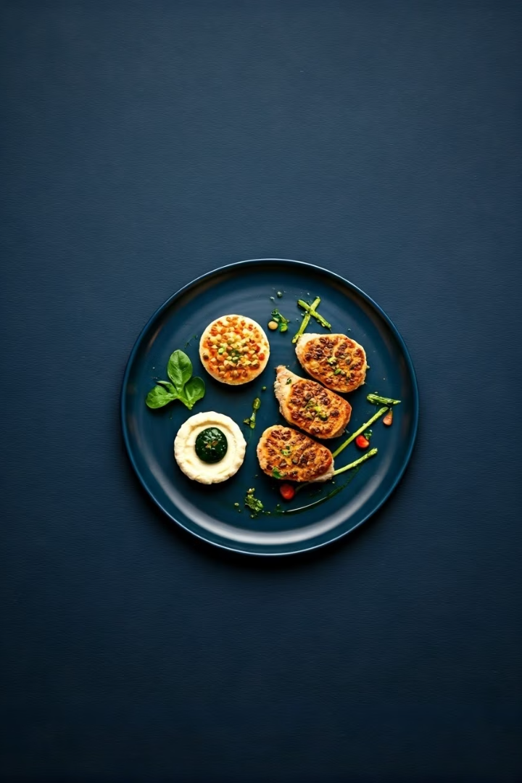
Feastly – A Recipe Sharing & Discovery App
COSC 4P02 – Software Engineering, Group 18
Presenters: Roger Li, Sahil Modi, Troy Bello, Ridham Elhance, Abdelgelil Mohamed, Michael Duru, Samrat Gautam

Slide 2
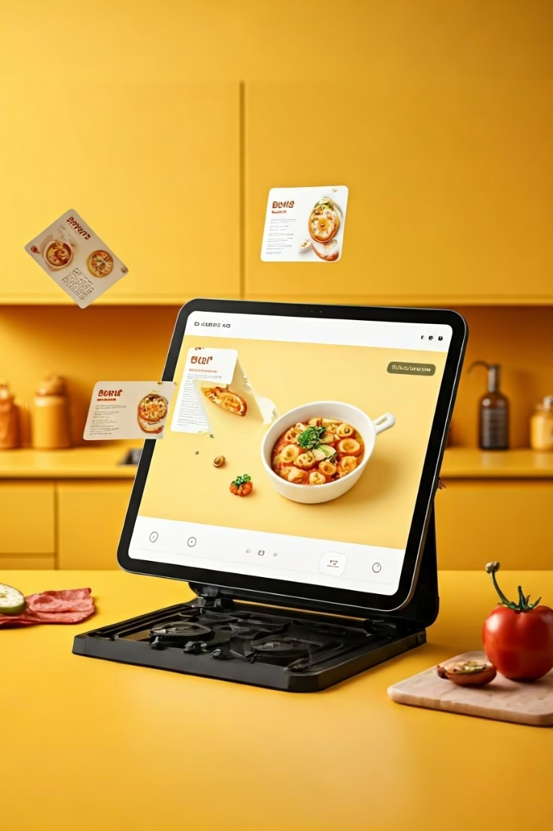

What is Feastly?
Web platform for discovering, saving, editing, and sharing recipes with AI integration

Slide 3

Project Overview
1
What is Feastly?
2
Target Users
3
Main Goal
Web platform for recipes
Home cooks, students, food enthusiasts
Easier, fun, community-driven meal planning

Slide 4
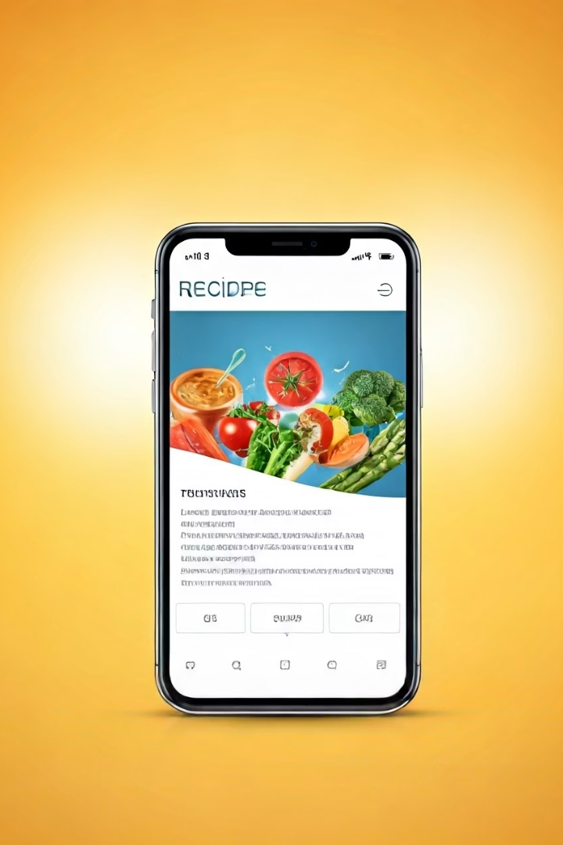




Key Features
Save & Edit Recipes
Share with Friends
AI Suggestions
Downloadable Cards

Slide 5



System Architecture
Frontend
1
React.js
Backend
2
Firebase & Firestore
AI Integration
3
Recipe Search, Substitutes, Summaries

Slide 6





Software Engineering Process
Design
2
Planning
1
Implementation
3
5
Feedback
4
Testing

Slide 7

Sprint Breakdown
Sprint 1-2
1
Setup, planning, UI mockups
2
Sprint 3-4
Basic components & database schema
Sprint 5-6
3
Frontend-Backend integration
4
Sprint 7-8
User testing, AI integration

Slide 8

Team Contribution
Troy Bello | UI framework, frontend support
Abdelgelil Mohamed | Firebase setup, testing integration
Sahil Modi | Design, user stories, survey creation
Samrat Gautam | Meetings, user stories, design, frontend coordination
Roger Li | Frontend lead, relation diagram, UI components
Ridham Elhance | Backend setup, Firestore integration
Michael Duru | Frontend components, GitHub setup, team coordination

Slide 9
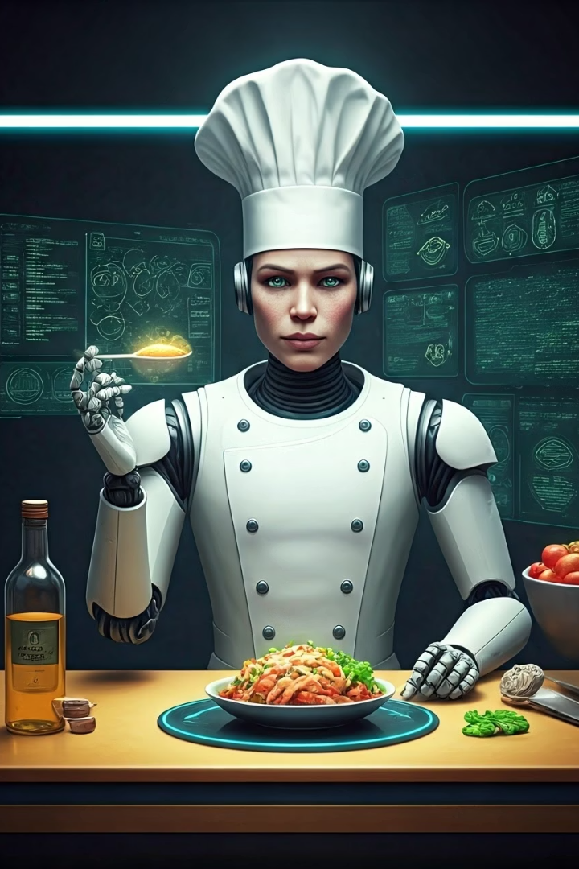
Project Demo
Homepage & Discovery Tab
Recipe Card View
All other features

Slide 10




Challenges and Solutions
Scheduling Conflicts
Used lecture time for meetings
Technical Learning Curve
Self-taught Firebase & React
Frontend-Backend Communication
Clear API structure

Slide 11
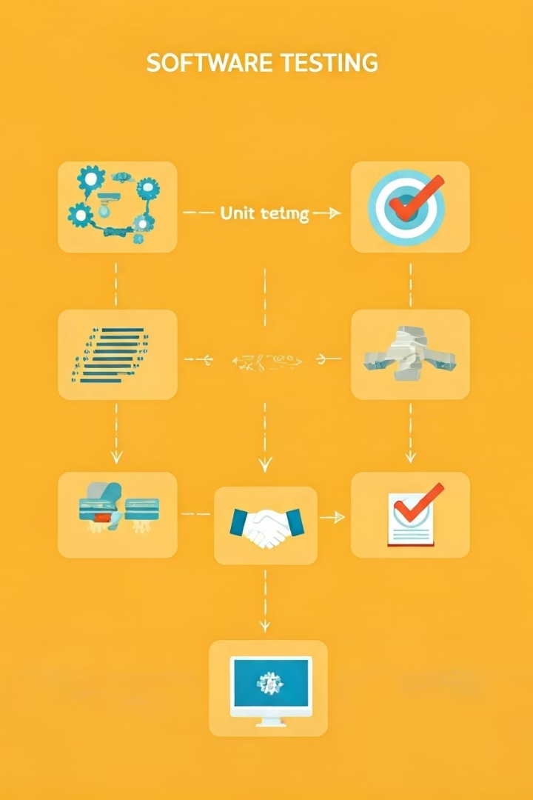
Testing & Results
Manual Tests
UI navigation, recipe saving
Backend Verification
Data stored/retrieved correctly
Cross-Browser Testing
Chrome, Firefox, Edge

Slide 12




Lessons Learned
Clear Communication
Managing Scope Creep
Crucial for team success
Set realistic goals
Collaboration
Strengthened frontend/backend collaboration skills

Slide 13

What's Next?
Future Improvements
Mobile App Version
Advanced AI for nutrition & meal planning
Recipe import from external sources
Release Plans
Public beta testing

Slide 14

Thank You! / Q&A

